Slide 1

Introductory Statistics
Introductory Statistics

Slide 2
Simple Linear Regression
Response vs. Explanatory Variable
Linear Regression Equation
Prediction
Fitting a Line on a Scatterplot

Slide 3
Explanatory Variable vs. Response Variable
Explanatory variable is used to predict the Response variable.
Explanatory variable=Independent Variable = X variable
Response variable = Dependent Variable = Y variable
Example 1 – Predicting body length of a crocodile using head length
Explanatory variable – Head Length
Response variable – Body Length
Example 2 – Does Number of Powerboat Registrations affect number of Manatee Killed?
Explanatory variable– Number of Powerboat Registrations
Response variable– Number of Manatee Killed

Slide 4
Simple Linear Regression
Response vs. Explanatory Variable
Linear Regression Equation
Prediction
Fitting a Line on a Scatterplot

Slide 5
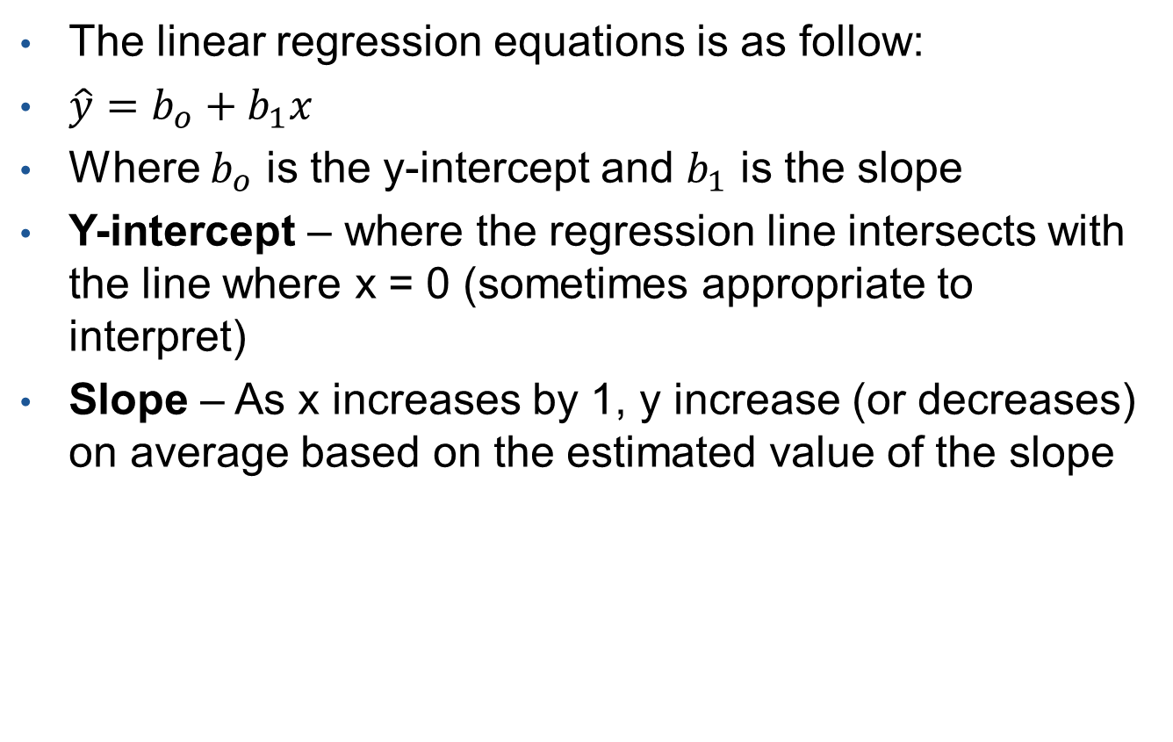
Linear Regression Equation
The linear regression equations is as follow:
$\hat{y}=b_{o}+b_{1}x$
Where $b_{o}$ is the y-intercept and $b_{1}$ is the slope
Y-intercept – where the regression line intersects with the line where x = 0 (sometimes appropriate to interpret)
Slope – As x increases by 1, y increase (or decreases) on average based on the estimated value of the slope

Slide 6
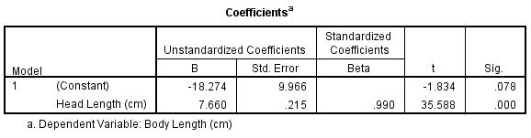
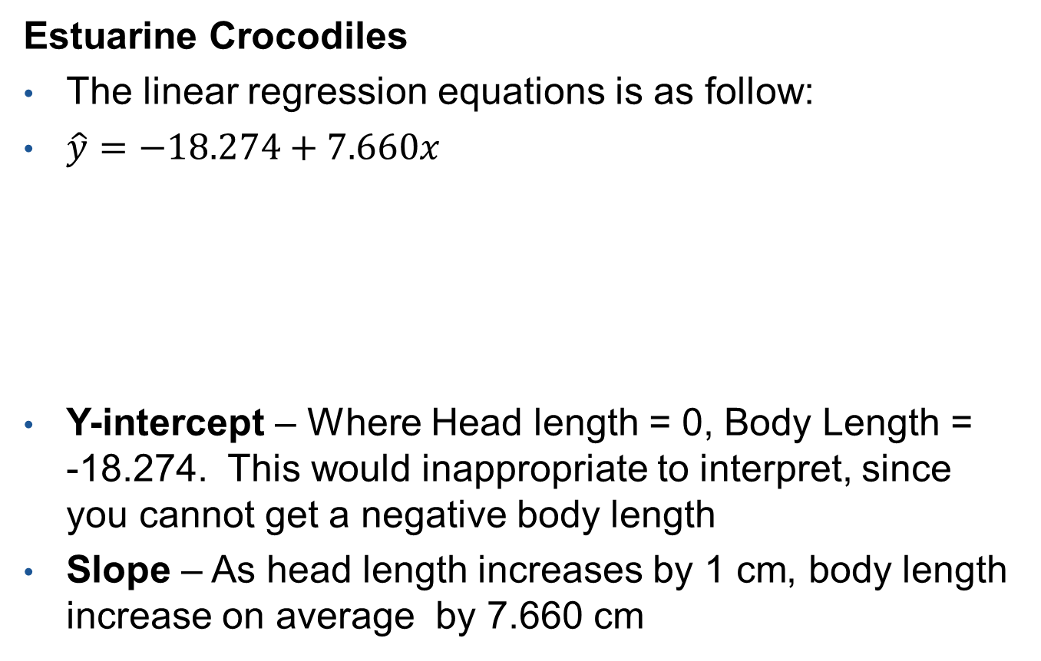
Linear Regression Equation (Example 1)
Estuarine Crocodiles
The linear regression equations is as follow:
$\hat{y}=−18.274+7.660x$
Y-intercept – Where Head length = 0, Body Length = -18.274. This would inappropriate to interpret, since you cannot get a negative body length
Slope – As head length increases by 1 cm, body length increase on average by 7.660 cm

Slide 7
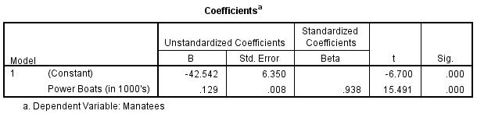
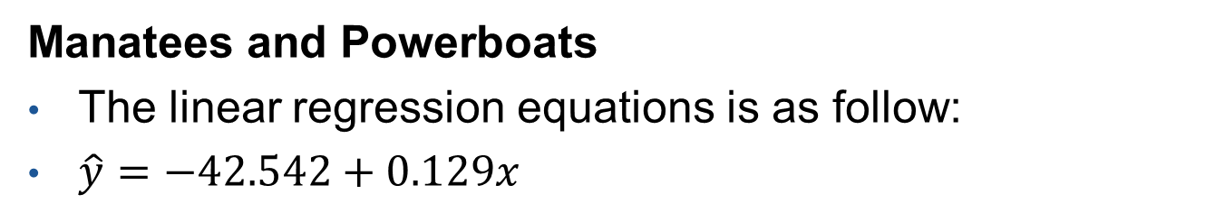
Linear Regression Equation (Example 2)
Manatees and Powerboats
The linear regression equations is as follow:
$\hat{y}=−42.542+0.129x$
Y-intercept – Where Number of Powerboats = 0, number of manatee killed = -42.542. This would inappropriate to interpret, since you cannot get a negative number for manatee killed.
Slope – As number of powerboats registered increase by 1(1000), the number of manatee killed on average increases by 0.129.

Slide 8
Simple Linear Regression
Response vs. Explanatory Variable
Linear Regression Equation
Prediction
Fitting a Line on a Scatterplot

Slide 9
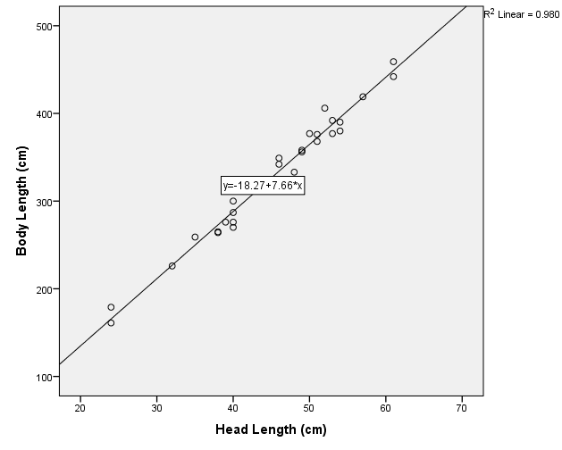
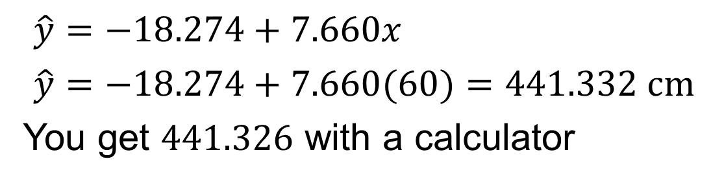
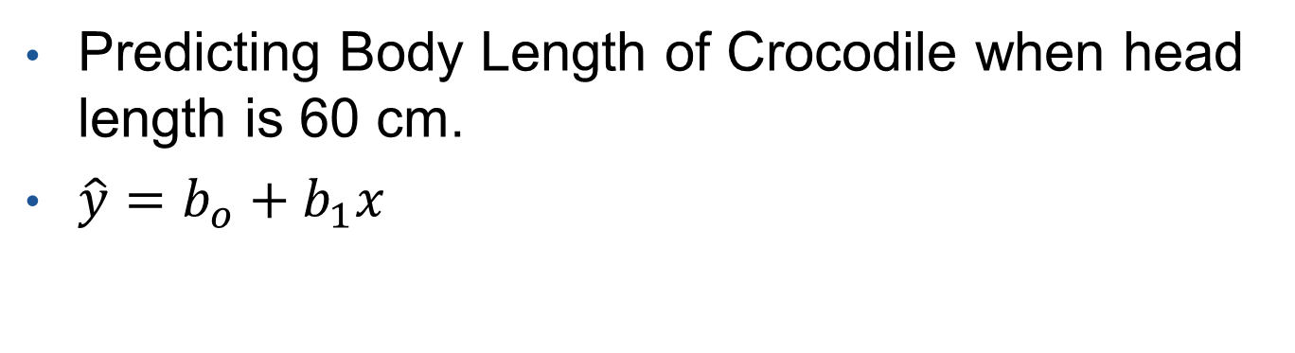
Predicting Y with a given X with a regression equation
Predicting Body Length of Crocodile when head length is 60 cm.
$\hat{y}=b_{o}+b_{1}x$
$\hat{y}=−18.274+7.660x$
$\hat{y}=−18.274+7.660(60)=441.332 cm$
You get $441.326$ with a calculator

Slide 10
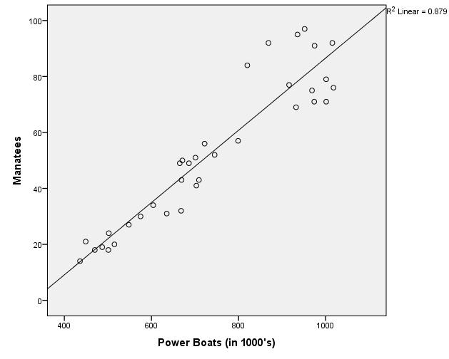
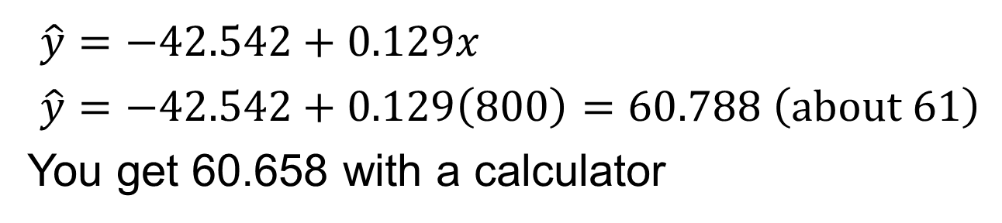
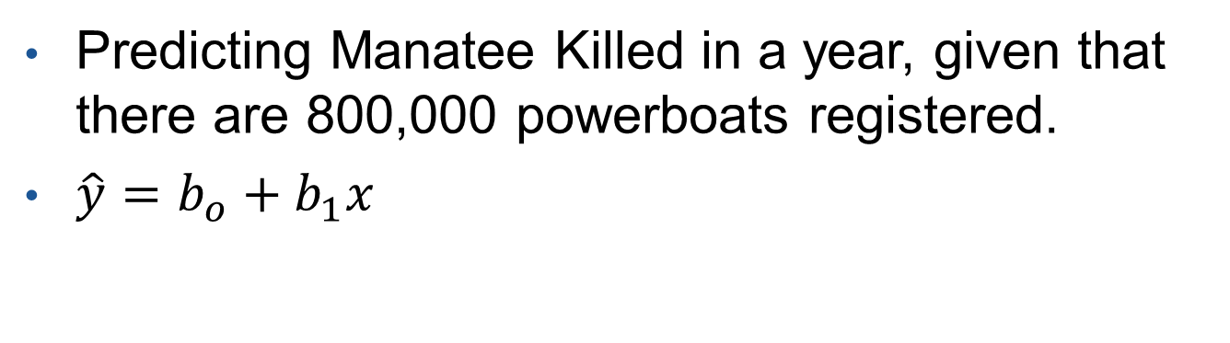
Predicting Y with a given X with a regression equation
Predicting Manatee Killed in a year, given that there are 800,000 powerboats registered.
$\hat{y}=b_{o}+b_{1}x$
$\hat{y}=−42.542+0.129x$
$\hat{y}=−42.542+0.129\left(800\right)=60.788 \left(about 61\right)$
You get 60.658 with a calculator

Slide 11
Simple Linear Regression
Response vs. Explanatory Variable
Linear Regression Equation
Prediction
Fitting a Line on a Scatterplot

Slide 12


Fitting an equation line on a Scatterplot
Fitting a Line on a Scatterplot
Estuarine Crocodiles
Manatee vs Powerboats
$$\hat{y}=−18.274+7.660x$$
$$\hat{y}=−42.542+0.129x$$

